Slide 1


A Major Project on An Implementation of Blockchain Technology in Forensic Evidence Management
Under the Guidance
of
RAHEEM UNNISA
(Assistant Professor)
BY
G.VIDYADHARI (197R1A05L2)
E.SHIVANI (197R1A05K7)
D.SUMANTH (197R1A05K6)

Slide 2
INTRODUCTION
Blockchain technology has the potential to revolutionize the management of forensic evidence by increasing transparency, security, and efficiency. In traditional forensic evidence management systems, there are often issues with chain of custody, data integrity, and accountability. By implementing blockchain technology, these issues can be addressed by creating an immutable and tamper-proof record of all transactions related to the evidence. This can enhance the accuracy and reliability of forensic evidence, improve the efficiency of forensic investigations, and increase trust in the criminal justice system. In this paper, we will explore the benefits and challenges of implementing blockchain technology in forensic evidence management, as well as potential use cases and future directions for research.

Slide 3
ABSTRACT
Evidence management is crucial in the field of forensic science. Evidences obtained from a crime scene are important in solving the case and delivering justice to the parties involved. Hence, protecting these evidences from any form of alteration is of utmost important. Chain of Custody is the process which maintains the integrity of evidence. Inability to maintain the chain of custody will make the evidence inadmissible in court, eventually leading to the case dismissal. Digitalization of forensic evidence management system is a need of time as it is an environment friendly model. Blockchains are digitally distributed ledgers of transactions signed cryptographically in chronological order that are sorted into blocks and is completely open to anyone in the blockchain network. Hyperledger Fabric is a consortium blockchain framework created by the Linux foundation and is mainly used for enterprise use. Based on the concept of Hyperledger Fabric, present study aimed to create a framework and further propose an algorithm to implement Blockchain Technology to digitalize forensic evidence management system and maintain Chain of Custody.

Slide 4
EXISTING SYSTEM
Evidence management is critical in the field of forensic science. Main concerns in forensic investigation are the management of evidences and their documentation. Starting from the point of collection till the final judgment from the court of law, maintaining the integrity of the evidence is of utmost importance . Evidences obtained from a crime scene are important in solving the case and delivering justice to the parties involved.

Slide 5
PROPOSED SYSTEM
Chain of Custody is the process which maintains the integrity of evidence. Inability to maintain the chain of custody will make the evidence inadmissible in court, eventually leading to the case dismissal. Digitalization of forensic evidence management system is a need of time as it is an environment friendly model. Blockchains are digitally distributed ledgers of transactions signed cryptographically in chronological order that are sorted into blocks and is completely open to anyone in the blockchain network. Hyperledger Fabric is a consortium blockchain framework created by the Linux foundation and is mainly used for enterprise use. Based on the concept of Hyperledger Fabric, present study aimed to create a framework and further propose an algorithm to Implement.

Slide 6
REQUIREMENTS
HARDWARE REQUIREMENTS:
Operating system : Windows, Linux
Processor :Minimum intel i3
Ram : Minimum 4gb
Hard disk : Minimum 250gb

Slide 7
REQUIREMENTS
SOFTWARE REQUIREMENTS:
Python idel 3.7 version (or)
Anaconda 3.7 ( or)
Jupiter (or)
Google colab

Slide 8
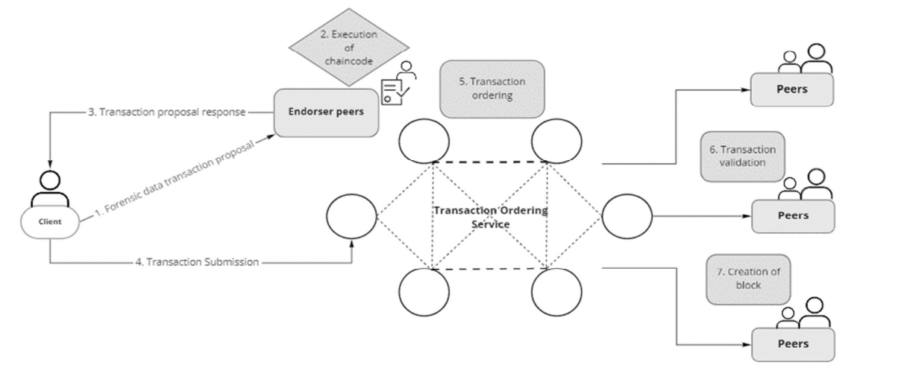
ARCHITECTURE

Slide 9
MODULES
To implement this project we have designed following modules
Admin Login: using this module police peoples can login to application by using username as ‘admin’ and password as ‘admin’.
Add Evidences to Blockchain: using this module police peoples can add evidences to Blockchain Ethereum tool
Fetch Evidences from Blockchain: using this module police peoples can extract all evidences stored in Blockchain and valid police peoples only can extract evidences from Blockchain.

Slide 10
UML DIAGRAMS
A UML diagram is a diagram with the purpose of visually representing a system along with its main actors, roles, actions, artifacts or classes, in order to better understand, alter, maintain, or document information about the system.
The following are the UML diagrams of our project:
Use Case Diagram
Class Diagram
Activity Diagram
Sequence Diagram

Slide 11
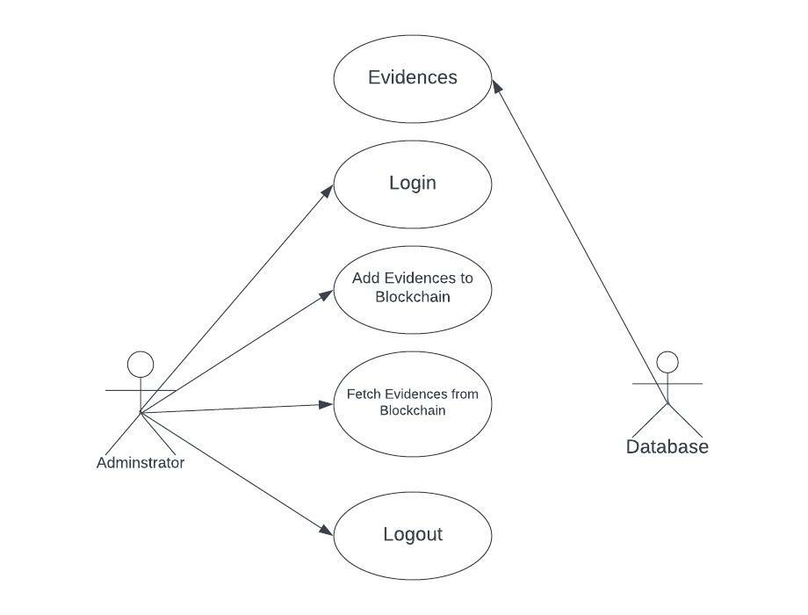
USE CASE DIAGRAM

Slide 12
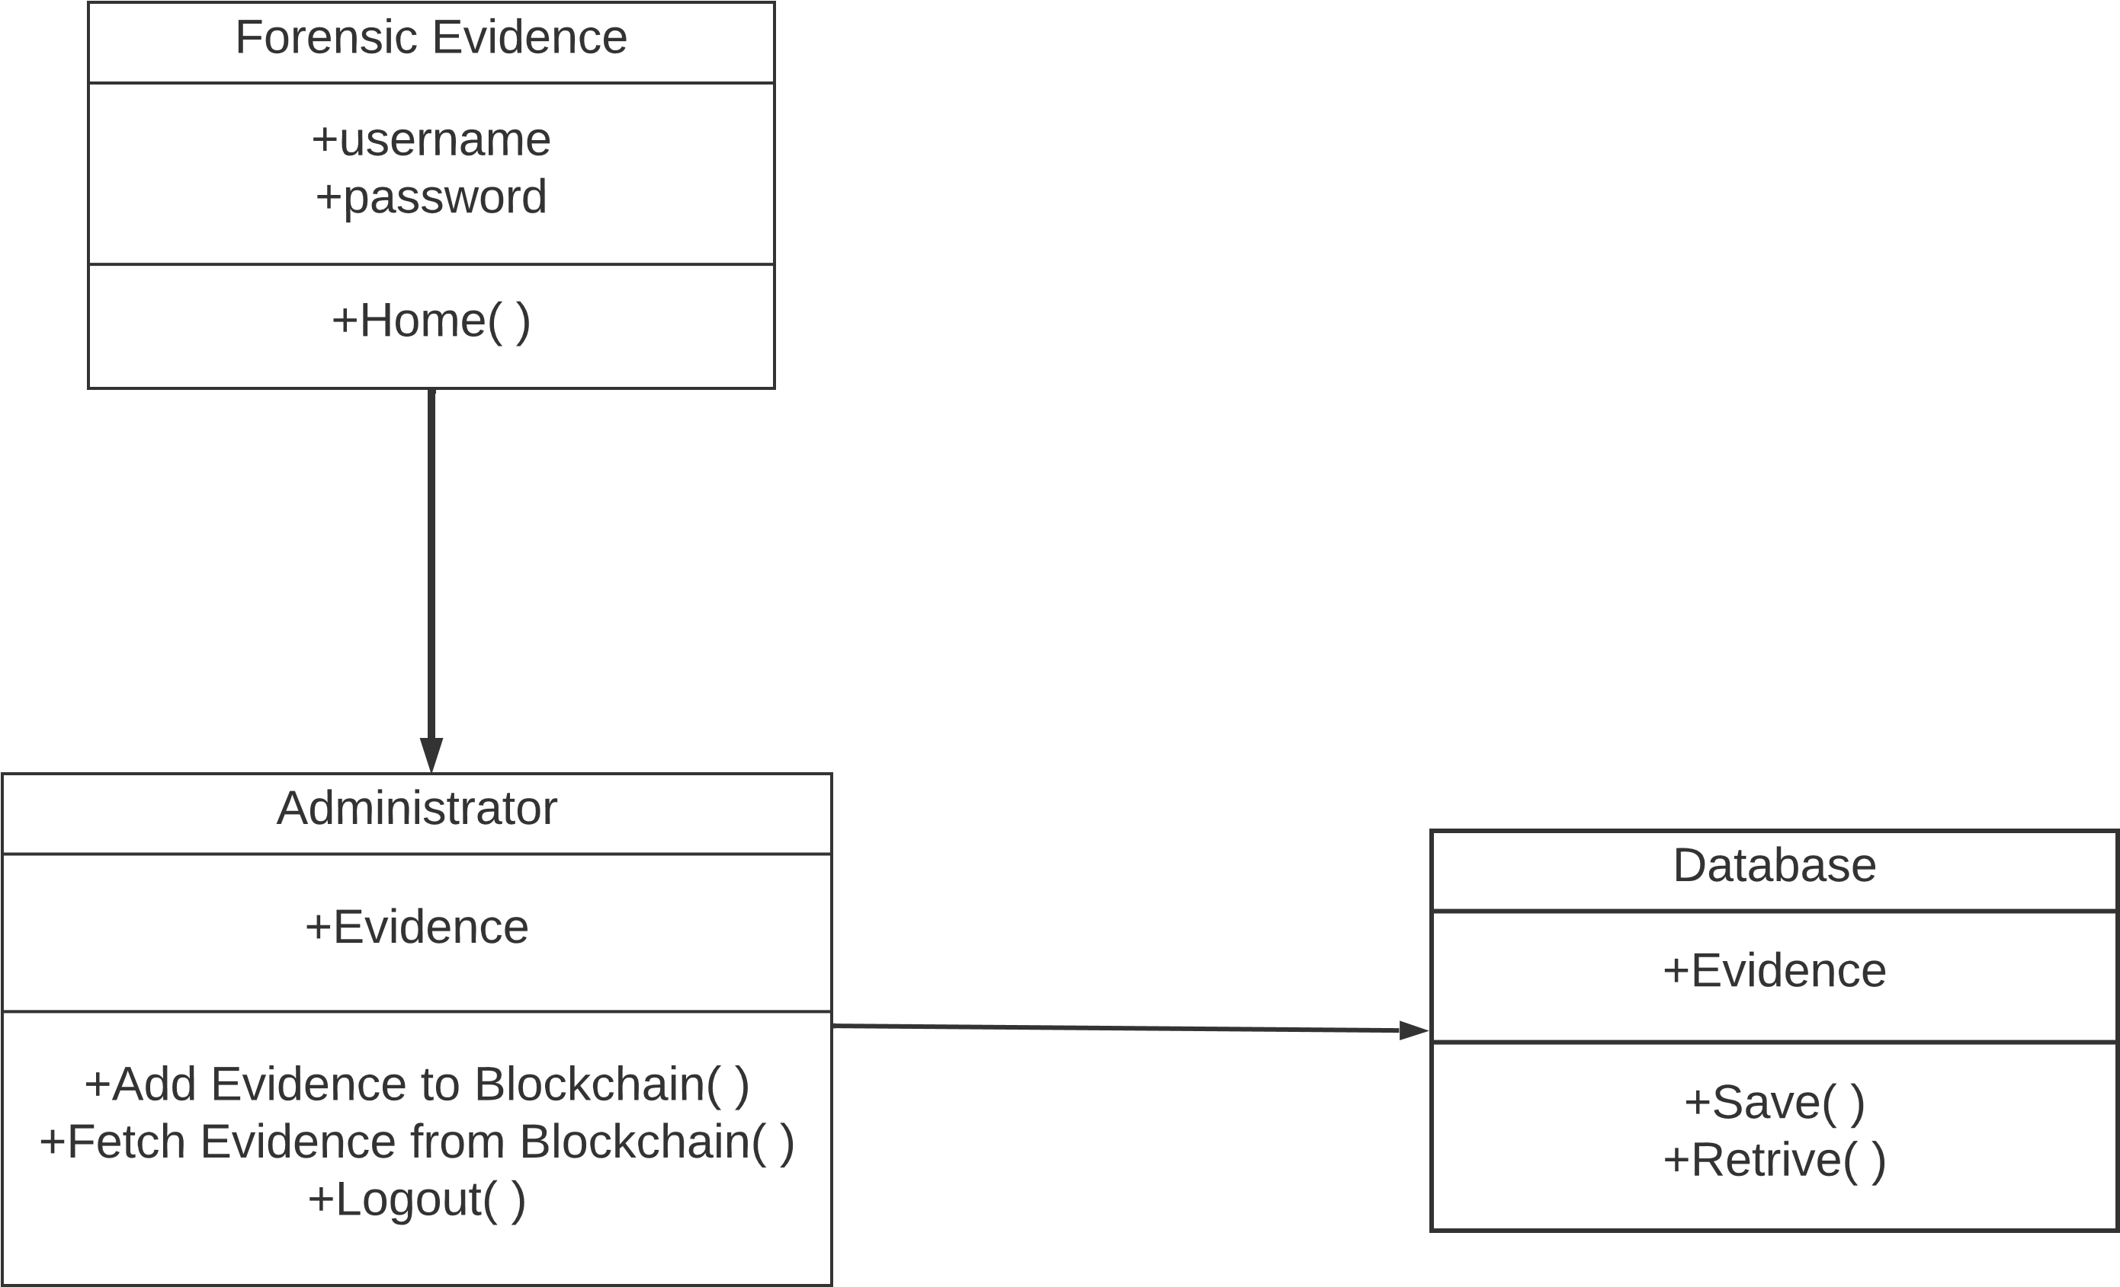
CLASS DIAGRAM

Slide 13
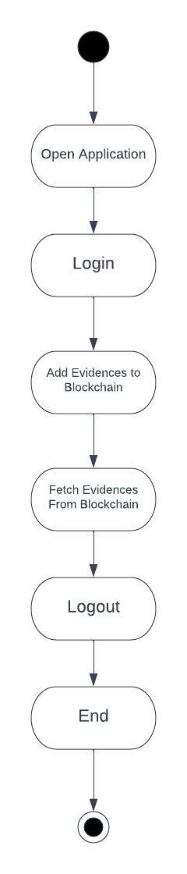
ACTIVITY DIAGRAM

Slide 14
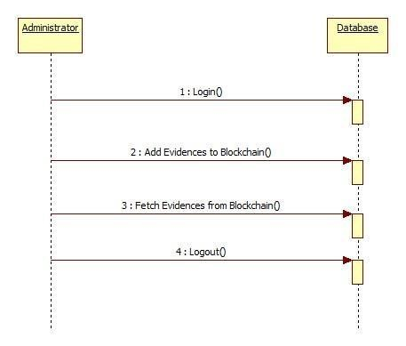

SEQUENCE DIAGARM

Slide 15
SAMPLE CODE
from django.shortcuts import render
from django.template import RequestContext
from django.contrib import messages
from django.http import HttpResponse
from django.conf import settings
from datetime import date
import json
from web3 import Web3, HTTPProvider
def readDetails():
global details
blockchain_address = 'http://127.0.0.1:9545' #Blokchain connection IP

Slide 16
SAMPLE CODE
web3 = Web3(HTTPProvider(blockchain_address))
web3.eth.defaultAccount = web3.eth.accounts[0]
compiled_contract_path = 'ForensicEvidenceContract.json' #forensic contract code
deployed_contract_address = '0xdbdeB1d0fe02FBE6a05f5C2194e187D3A92F2229’
#hash address to access forensiccontract
with open(compiled_contract_path) as file:
contract_json = json.load(file) # load contract info as JSON
contract_abi = contract_json['abi'] # fetch contract's abi - necessary to call its functions
file.close()
contract = web3.eth.contract(address=deployed_contract_address, abi=contract_abi)
details = contract.functions.getData().call()
if len(details) > 0:

Slide 17

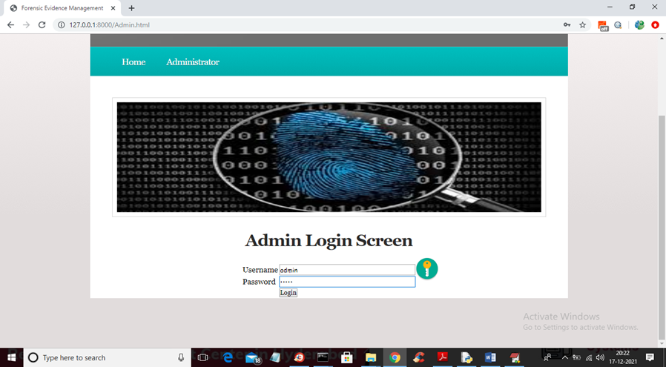
RESULTS

Slide 18
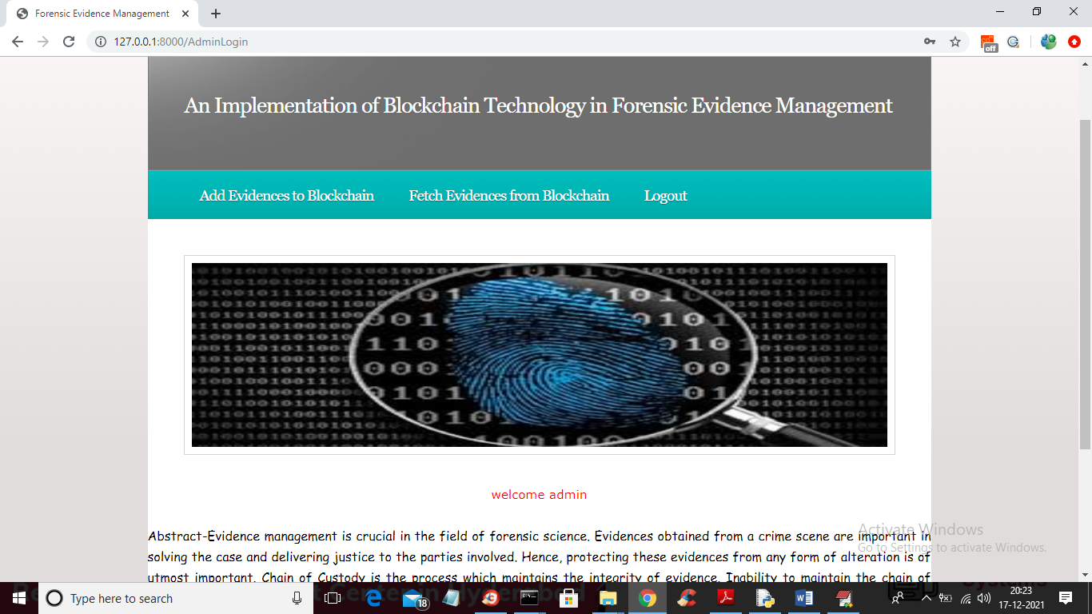
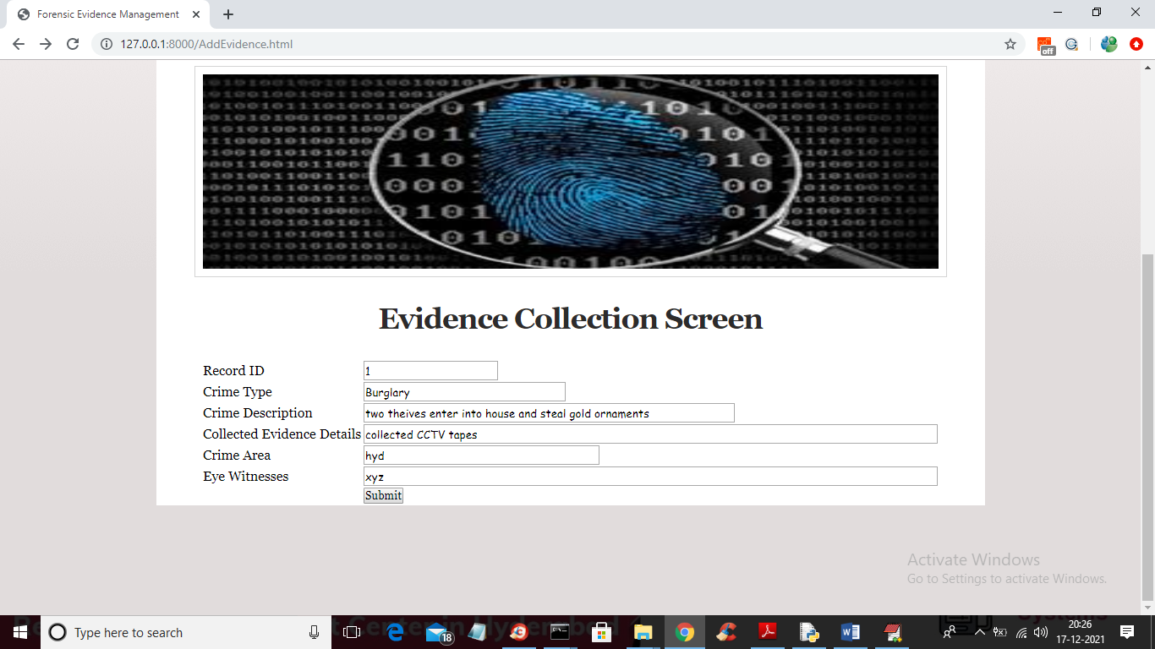
RESULTS

Slide 19
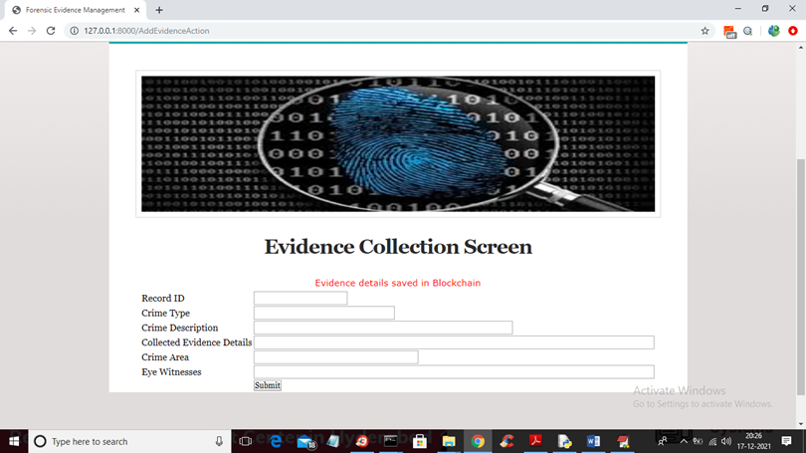
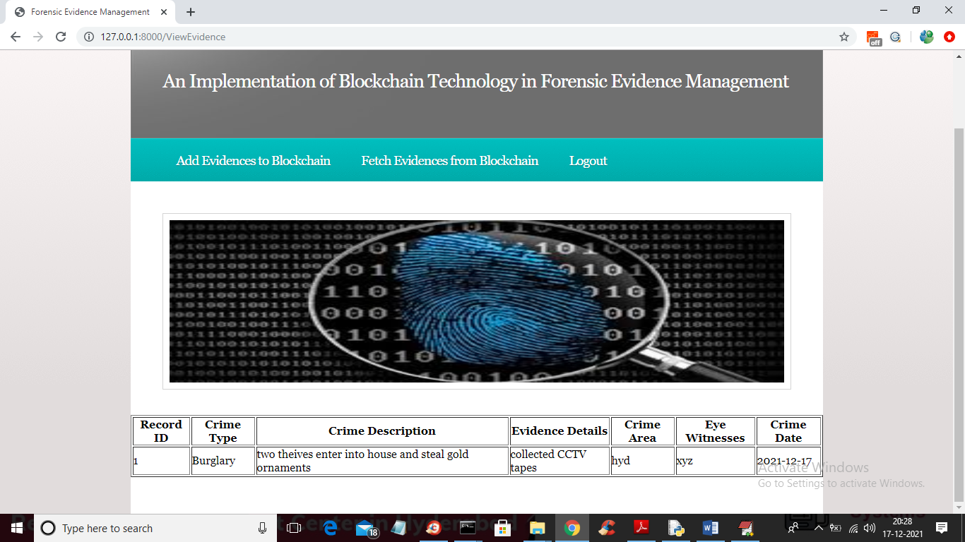
RESULTS

Slide 20
CONCLUSION
From the time evidence is collected from the crime scene until court of law make the judgment, maintaining the integrity of the evidence is of most importance. Maintaining the chain of custody is important as it can prove if the evidence is tampered or not during the collection and analysis process. Implementation of Blockchain technology to digitalize chain of custody will ensure security, authenticity and integrity of the forensic data transactions. Application of blockchain will not only make it environment friendly but also increase security with the help of encryption which can be accessed remotely by authorized personnel. We intend to work on an algorithm that executes the chain of custody process utilizing blockchain technology, specifically Hyperledger Fabric. Furthermore, we can couple blockchain technology with artificial intelligence/ machine learning which will help in forensic investigation.

Slide 21
THANK YOU

